Slide 1
C++
Dr. Zahid Halim

Slide 2
1 // Fig. 1.2: fig01_02.cpp
2 // A first program in C++
Comments
Written between /* and */ or following a //.
Improve program readability and do not cause the computer to perform any action.
3 #include <iostream>
4
5 int main()
6 {
preprocessor directive
Message to the C++ preprocessor.
Lines beginning with # are preprocessor directives.
#include <iostream> tells the preprocessor to include the contents of the file <iostream>, which includes input/output operations (such as printing to the screen).
7 std::cout << "Welcome to C++!\n";
8
9 return 0; // indicate that program ended successfully
10 }
C++ programs contain one or more functions, one of which must be main
Parenthesis are used to indicate a function
int means that main "returns" an integer value. More in Chapter 3.
Welcome to C++!
Prints the string of characters contained between the quotation marks.
The entire line, including std::cout, the << operator, the string "Welcome to C++!\n" and the semicolon (;), is called a statement.
All statements must end with a semicolon.
return is a way to exit a function from a function.
return 0, in this case, means that the program terminated normally.
A left brace { begins the body of every function and a right brace } ends it.

Slide 3
A Simple Program:
Printing a Line of Text
std::cout
  Standard output stream object
  “Connected” to the screen
  std:: specifies the "namespace" which cout belongs to
    std:: can be removed through the use of using statements
<<
  Stream insertion operator
  Value to the right of the operator (right operand) inserted into output stream (which is connected to the screen)
  std::cout << “Welcome to C++!\n”;
\
  Escape character
  Indicates that a “special” character is to be output

Slide 4
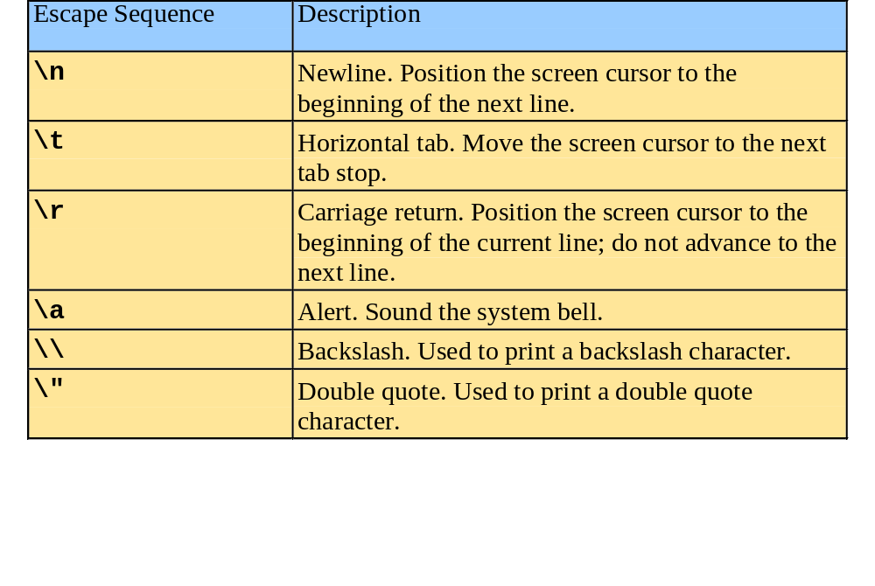
Simple Program:
Printing a Line of Text
There are multiple ways to print text
  Following are more examples

Slide 5
1 // Fig. 1.4: fig01_04.cpp
2 // Printing a line with multiple statements
3 #include <iostream>
4
5 int main()
6 {
7 std::cout << "Welcome ";
8 std::cout << "to C++!\n";
9
10 return 0; // indicate that program ended successfully
11 }
Welcome to C++!
Unless new line '\n' is specified, the text continues on the same line.

Slide 6
1 // Fig. 1.5: fig01_05.cpp
2 // Printing multiple lines with a single statement
3 #include <iostream>
4
5 int main()
6 {
7 std::cout << "Welcome\nto\n\nC++!\n";
8
9 return 0; // indicate that program ended successfully
10 }
Welcome
to
C++!
Multiple lines can be printed with one statement.

Slide 7
Another Simple Program:
Adding Two Integers
Variables
  Location in memory where a value can be stored for use by a program
  Must be declared with a name and a data type before they can be used
  Some common data types are:
    int - integer numbers
    char - characters
    double - floating point numbers
  Example: int myvariable;
    Declares a variable named myvariable of type int
  Example: int variable1, variable2;
    Declares two variables, each of type int

Slide 8
Another Simple Program:
Adding Two Integers
>> (stream extraction operator)
  When used with std::cin, waits for the user to input a value and stores the value in the variable to the right of the operator
  The user types a value, then presses the Enter (Return) key to send the data to the computer
  Example:
      int myVariable;
      std::cin >> myVariable;
    Waits for user input, then stores input in myVariable
= (assignment operator)
  Assigns value to a variable
  Binary operator (has two operands)
  Example:
      sum = variable1 + variable2;

Slide 9
1 // Fig. 1.6: fig01_06.cpp
2 // Addition program
3 #include <iostream>
4
5 int main()
6 {
7 int integer1, integer2, sum; // declaration
8
9 std::cout << "Enter first integer\n"; // prompt
Notice how std::cin is used to get user input.
10 std::cin >> integer1; // read an integer
11 std::cout << "Enter second integer\n"; // prompt
12 std::cin >> integer2; // read an integer
13 sum = integer1 + integer2; // assignment of sum
14 std::cout << "Sum is " << sum << std::endl; // print sum
15
16 return 0; // indicate that program ended successfully
std::endl flushes the buffer and prints a newline.
17 }
Enter first integer
45
Enter second integer
72
Sum is 117
Variables can be output using std::cout << variableName.

Slide 10
Memory Concepts
Variable names
  Correspond to locations in the computer's memory
  Every variable has a name, a type, a size and a value
  Whenever a new value is placed into a variable, it replaces the previous value - it is destroyed
  Reading variables from memory does not change them
A visual representation
integer1
45

Slide 11
Quiz 2
  Write a C++ program to input 5 numbers using while loop and find there sum, average, and product.

Slide 12
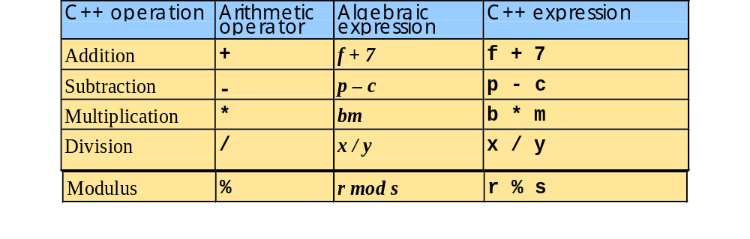
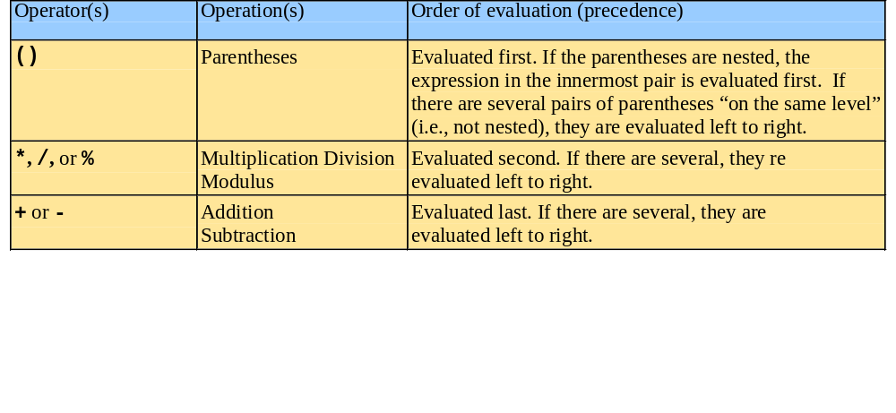
Arithmetic
Arithmetic operators:
Rules of operator precedence:

Slide 13
Decision Making: Equality and Relational Operators
if structure
  Test conditions truth or falsity. If condition met execute, otherwise ignore
Equality and relational operators
  Lower precedence than arithmetic operators
Table of relational operators on next slide

Slide 14
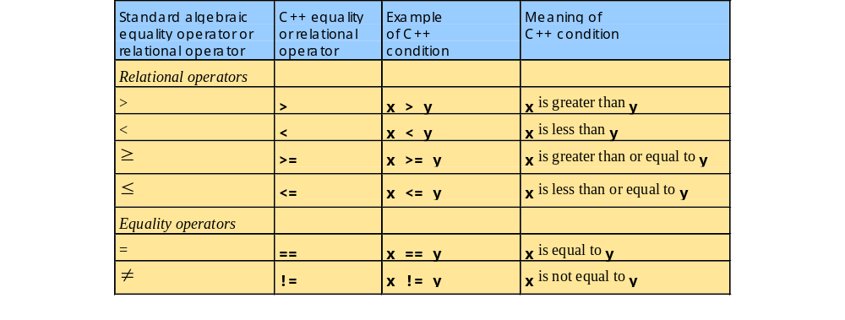
Decision Making: Equality and Relational Operators

Slide 15
Decision Making: Equality and Relational Operators
using statements
  Eliminate the need to use the std:: prefix
  Allow us to write cout instead of std::cout
  To use the following functions without the std:: prefix, write the following at the top of the program
        using std::cout;
        using std::cin;
        using std::endl;

Slide 16
1 // Fig. 1.14: fig01_14.cpp
2 // Using if statements, relational
3 // operators, and equality operators
4 #include <iostream>
5
6 using std::cout; // program uses cout
Notice the using statements.
7 using std::cin; // program uses cin
8 using std::endl; // program uses endl
9
10 int main()
11 {
12 int num1, num2;
13
14 cout << "Enter two integers, and I will tell you\n"
15 << "the relationships they satisfy: ";
16 cin >> num1 >> num2; // read two integers
Enter two integers, and I will tell you
the relationships they satisfy: 3 7
17
18 if ( num1 == num2 )
19 cout << num1 << " is equal to " << num2 << endl;
The if statements test the truth of the condition. If it is true, body of if statement is executed. If not, body is skipped.
To include multiple statements in a body, delineate them with braces {}.
20
21 if ( num1 != num2 )
22 cout << num1 << " is not equal to " << num2 << endl;
3 is not equal to 7
23
24 if ( num1 < num2 )
25 cout << num1 << " is less than " << num2 << endl;
3 is less than 7
26
27 if ( num1 > num2 )
28 cout << num1 << " is greater than " << num2 << endl;
29
30 if ( num1 <= num2 )
31 cout << num1 << " is less than or equal to "
3 is less than or equal to 7
32 << num2 << endl;
33

Slide 17
34 if ( num1 >= num2 )
35 cout << num1 << " is greater than or equal to "
36 << num2 << endl;
37
38 return 0; // indicate that program ended successfully
39 }
Enter two integers, and I will tell you
the relationships they satisfy: 3 7
3 is not equal to 7
3 is less than 7
3 is less than or equal to 7
Enter two integers, and I will tell you
the relationships they satisfy: 22 12
22 is not equal to 12
22 is greater than 12
22 is greater than or equal to 12
Enter two integers, and I will tell you
the relationships they satisfy: 7 7
7 is equal to 7
7 is less than or equal to 7
7 is greater than or equal to 7

Slide 18
References
  Dietal and Dietal : How to Program C++
  3rd Edition

